Slide 1


How Threat Modeling Made Me Better at Online Dating
#DateSafe
Isaiah Sarju

Slide 2
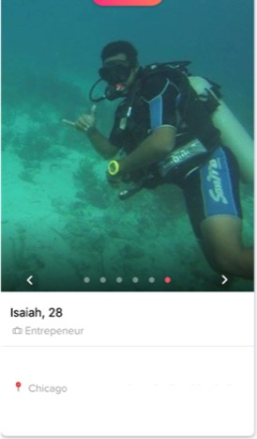
Who am I
Security consultant, co-owner Revis Solutions
Red teamer
Teacher
Anti: nihilism, security theater, wasted time
Pro: risk based security
Love chocolate chip cookies

Slide 3
Who is this talk for? People who want to…
Know what threat modeling is
Learn basic steps to do threat modeling
Apply threat modeling to development stages or end-user usage
Learn tips for online dating (regarding security)
Gain a basic understanding of
Data flow diagrams
STRIDE
Attack Trees
Principle of nymity/linkability

Slide 4
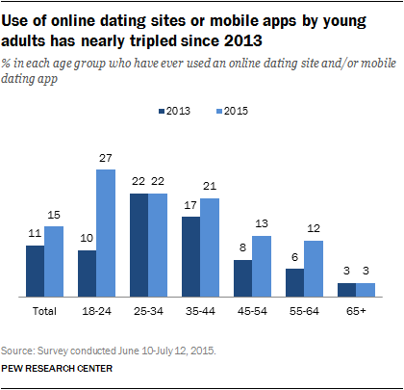
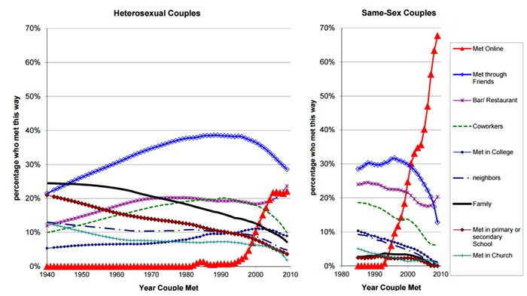
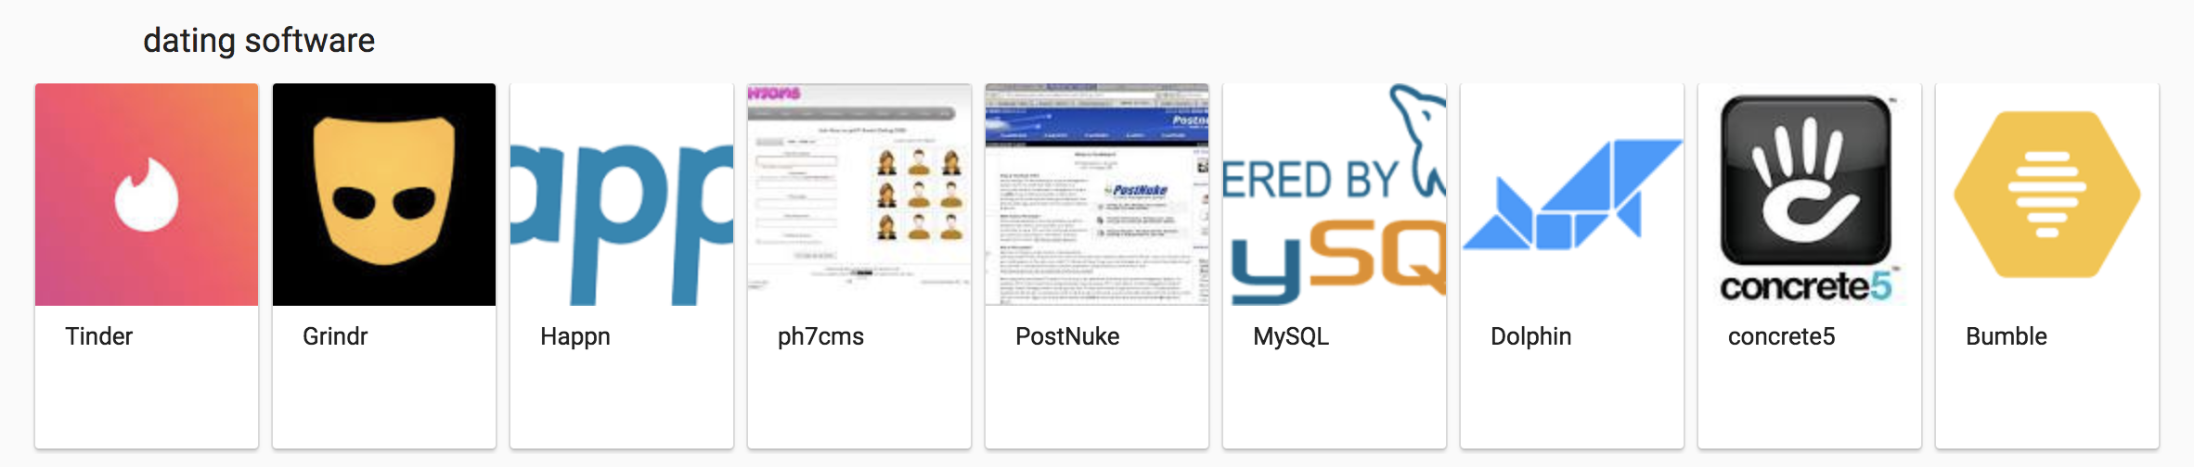
Technology and Dating

Slide 5
Applications to Online Dating
security nihilism
Promote
safe/positive interactions
Build
more privacy/security centric applications
Protect
users:
LGBTQ, Non-normative sexual/romantic preferences, People with disabilities, _____ minorities, (Everyone)
Avoid

Slide 6
Consequences of Bad Threat Modeling
There are many
Data Linking Disclosure
Tinder Matching Disclosure

Slide 7
DFD

Slide 8
Data flow diagrams “Problems tend to follow the data flow, not the control flow” – Adam Shostack
Decompose application processes
Understand data flow
Apply STRIDE to each step of the way

Slide 9
DFD

Slide 10
Tinder Front End/Client Risk
STRIDE | Example
Spoofing (Authentication) | Falsely claiming to be Isaiah Sarju on Tinder (Bumble offers “verification”)
Tampering (Integrity) | Changing a presented profile, changing a swipe
Repudiation (Non-repudiation) | “I didn’t swipe right on that person”
Information Disclosure (Confidentiality) | Disclosing swipe decision, disclosing matches/chats
Denial of Service (Availability) | Not able to connect to front end via client
Elevation of Privileges (Authorization) | Able to see profiles w/o matching, Facebook “view as” breach

Slide 11
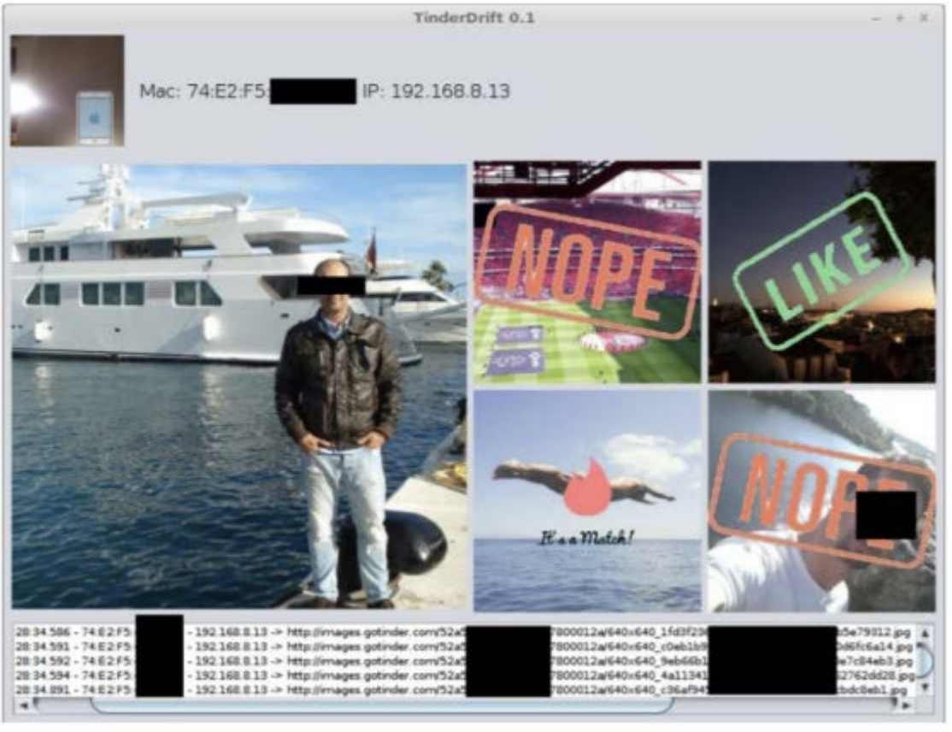
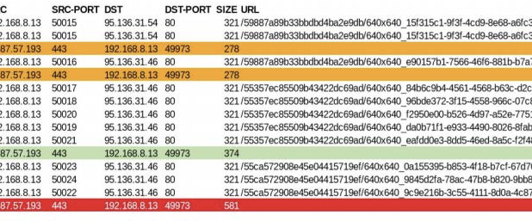
Tinder Information Disclosure (Checkmarx research)

Slide 12
Risk Management Techniques
Acceptance
Avoidance
Transference
Mitigation/Reduction

Slide 13
Risk Handling
App | User
HTTPs (mitigation) | VPN (mitigation)
Standardize response size (mitigation) | Only swipe at home (avoidance)
Don’t care (acceptance) | Don’t care (acceptance)

Slide 14
Attack Trees and Nymity/Linkability

Slide 15
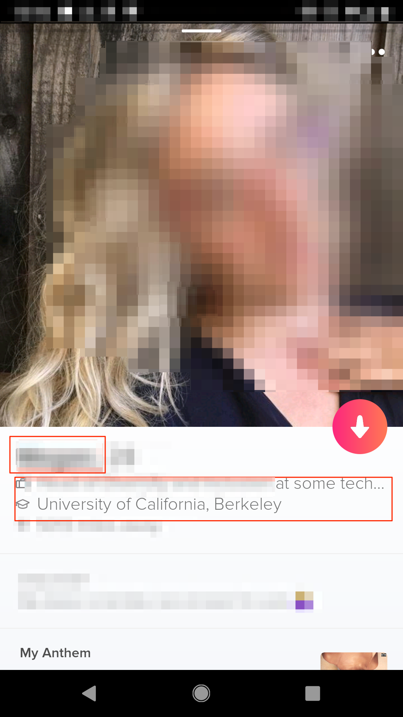
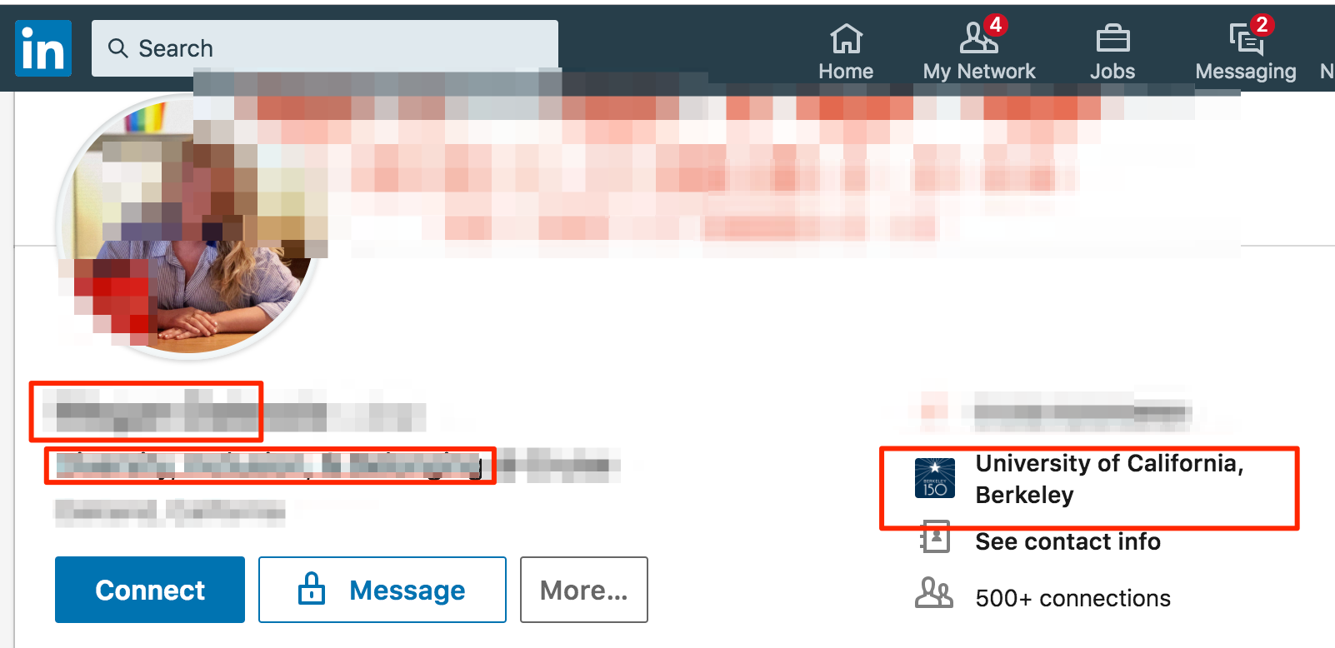
Nymity and Linkability
Nymity is the “amount of information about the identity of the participants that is revealed” – Ian Goldberg
Linkability is the ability to bring one or more records together and combine information into a single record based on key(s) (virtual join)

Slide 16
Risk Handling
App | User
Allow users to chose what information they disclose(transference) | Don’t date (avoidance)
Don’t disclose Instagram handle (reduction) (e.g. Tinder vs Bumble) *Update | Fake name (reduction)
Fuzzy/delayed location data (reduction) (e.g. Tinder vs Bumble) | Don’t disclose employer (reduction)
Give users ability to hide distance (transference) (e.g. Tinder) | Don’t connect Instagram (reduction)
 | Prevent realtime location sharing (reduction) (iPhone vs Android)
 | Don’t disclose distance (mitigation) (e.g. Tinder)
 | Spoof location (mitigation)
 | Don’t care (acceptance)

Slide 17
DFD

Slide 18
Risk Handling
App | User
Allow users to chose what information they disclose(transference) | Don’t date (avoidance)
Don’t disclose Instagram handle (reduction) (e.g. Tinder vs Bumble) *Update | Fake name (reduction)
Fuzzy/delayed location data (reduction) (e.g. Tinder vs Bumble) | Don’t disclose employer (reduction)
Give users ability to hide distance (transference) (e.g. Tinder) | Don’t connect Instagram (reduction)
 | Prevent realtime location sharing (reduction) (iPhone vs Android)
 | Don’t disclose distance (mitigation) (e.g. Tinder)
 | Spoof location (mitigation)
 | Don’t care (acceptance)

Slide 19
My Love of Threat Modeling
Helps builders build better
Helps defenders think intentionally
Helps attackers prioritize attacks
Helps everyone make intentional decisions about data responsibility

Slide 20
Sources
Hergovich, Philipp and Ortega, Josue, The Strength of Absent Ties: Social Integration via Online Dating (September 14, 2018), https://arxiv.org/pdf/1709.10478.pdf
Smith, Aaron, and Monica Anderson. “5 Facts about Online Dating.” Pew Research Center, Pew Research Center, 29 Feb. 2016, www.pewresearch.org/fact-tank/2016/02/29/5-facts-about-online-dating/.
C. Fitzpatrick, J. Birnholtz and J. R. Brubaker, "Social and Personal Disclosure in a Location-Based Real Time Dating App," 2015 48th Hawaii International Conference on System Sciences, Kauai, HI, 2015, pp. 1983-1992. doi: 10.1109/HICSS.2015.237, http://ieeexplore.ieee.org/stamp/stamp.jsp?tp=&arnumber=7070049&isnumber=7069647
Ghorayshi, Azeen. “Grindr Is Sharing The HIV Status Of Its Users With Other Companies.” BuzzFeed News, BuzzFeed News, 3 Apr. 2018, www.buzzfeednews.com/article/azeenghorayshi/grindr-hiv-status-privacy#.yp0J48W0N.
Nandwani M., Kaushal R. (2018) Evaluating User Vulnerability to Privacy Disclosures over Online Dating Platforms. In: Barolli L., Enokido T. (eds) Innovative Mobile and Internet Services in Ubiquitous Computing. IMIS 2017. Advances in Intelligent Systems and Computing, vol 612. Springer, Cham
Duportail, Judith. “I Asked Tinder for My Data. It Sent Me 800 Pages of My Deepest, Darkest Secrets.” The Guardian, Guardian News and Media, 26 Sept. 2017, www.theguardian.com/technology/2017/sep/26/tinder-personal-data-dating-app-messages-hacked-sold.
“Are You on Tinder?” Checkmarx, Jan 2018. https://info.checkmarx.com/hubfs/Tinder_Research.pdf.
Shostack, Adam. Threat Modeling: Designing for Security. Wiley, 2014.

Slide 21
Q’s

Slide 22
Info
@isaiahsarju all over The Internet
https://github.com/isaiahsarju/presentations

